Slide 1
Spring Boot
A framework for production grade enterprise applications
Saurav Sanyal, Syed Suhail

Slide 2
Agenda
01
02
03
04
05
06
Understanding Web Apps and Backend Engineering.
Intro To Spring
Core Spring Concepts
Creating a Spring Project
ReST API Development
Hands on Exercises

Slide 3
Trainer Quick Intro
Syed Ameer Suhail
7.5 Years of experience in Backend Development
Currently working as a Lead Software Engineer - Sales order Domain.
Joined Ferguson in May 2025.
Core Expertise: Java, Spring Boot, Microservices, Cloud (Azure) & Backend Systems.
Saurav Sanyal
Software Engineer with 6+ YoE in building backend and enterprise applications.
Currently working as Lead Software Engineer at Omni#1 team, working on APIs, middleware, integrations, and event-driven systems.
My core expertise includes Java, Spring Boot, Microservices, Cloud, Databases, and Distributed Systems.
Currently expanding into AI Engineering, with hands-on work in RAG, LLMs, Vector Search, and AI-powered applications.

Slide 4
Introduction to Web Applications
1
2
3
What is a Web Application?
Examples of Web Applications
Components/Layers
Where Does the Backend Sit?
Browser → Backend → Database Flow
What Does a Backend Do?
Receive Requests
Business Logic Processing
Database Interaction
API Integration
Return Responses

Slide 5
Web Application
A Web application is a interactive software application that you can access through a web browser over the internet.
Examples :
Online Banking
E-commerce Application
Food Delivery app
Social media platform
Learning Portal

Slide 6
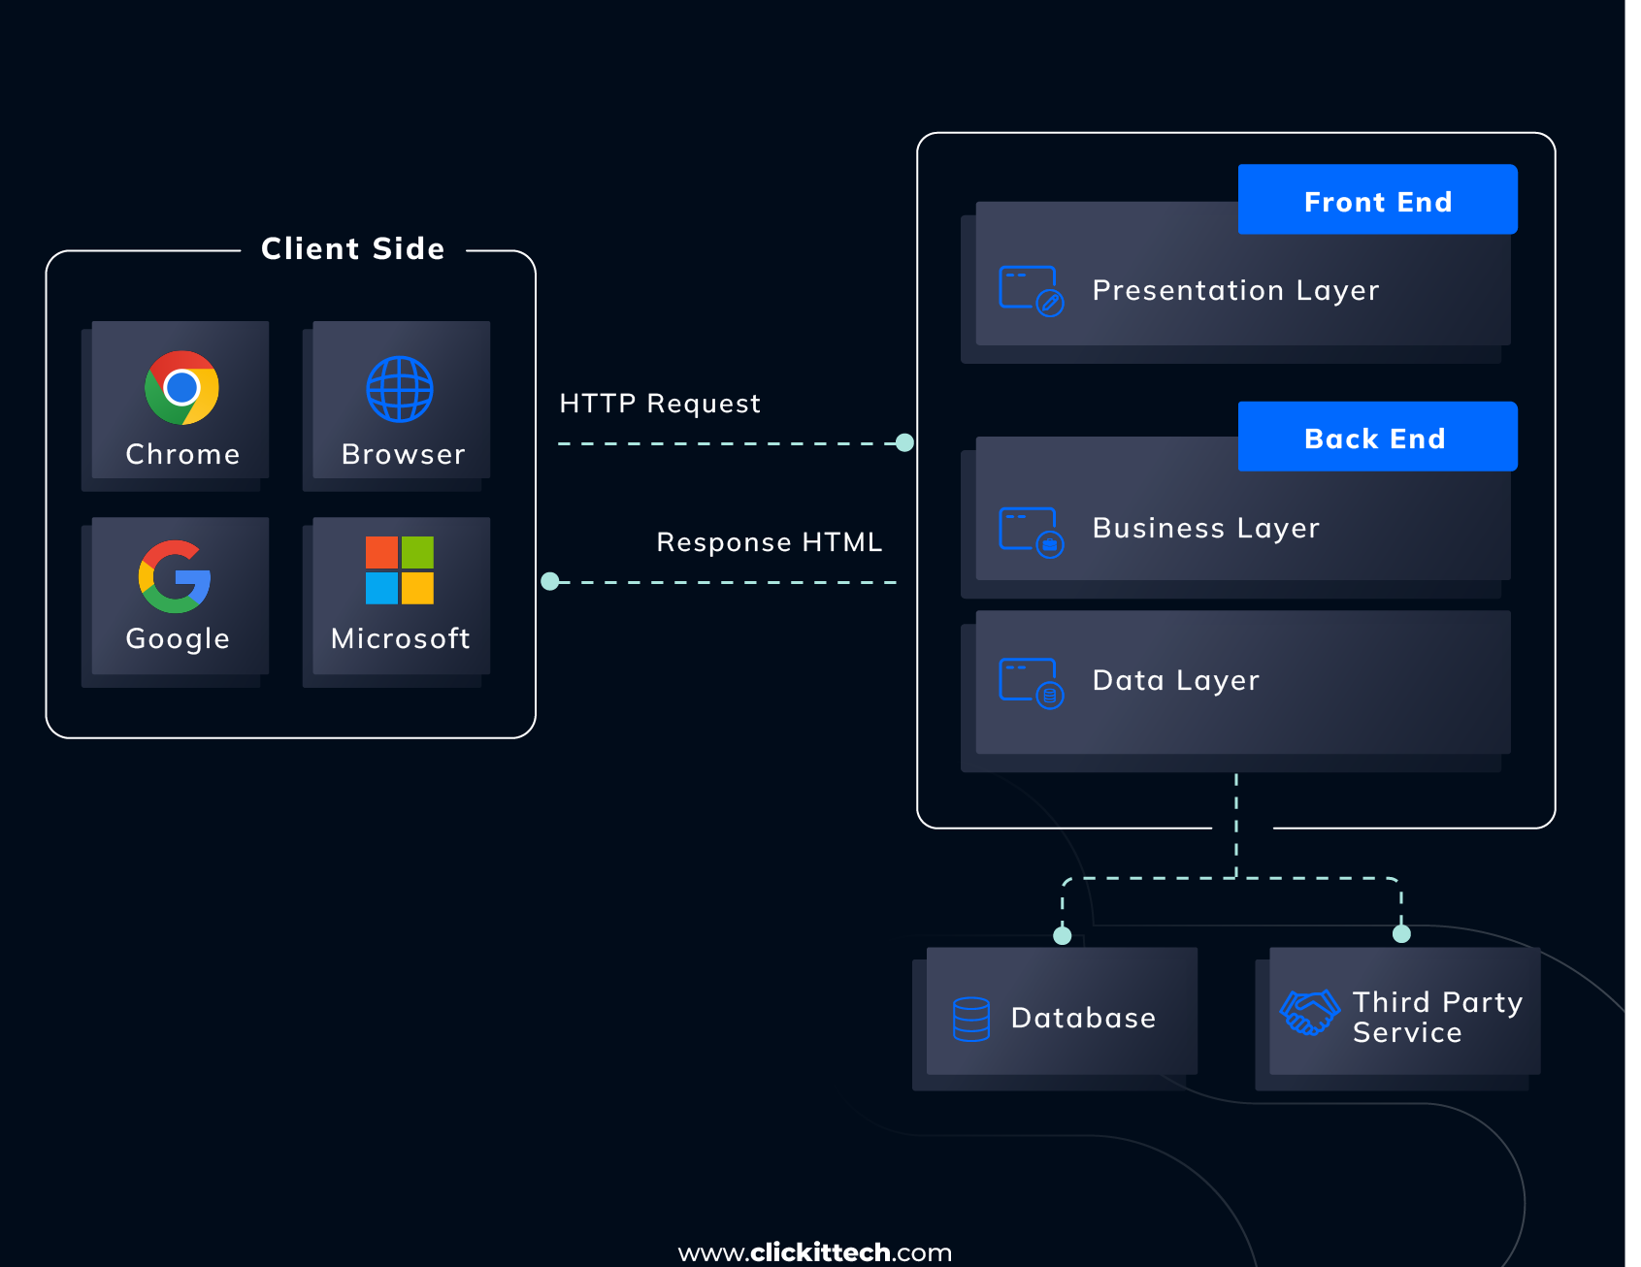
Standard Web Application Architecture
Web Application Architecture

Slide 7
Backend In Web Apps
API Communication: It acts as a bridge, passing information back and forth between the database, the server, and the user's web browser or mobile app.
User Authentication & Authorization: It checks who you are when you log in, ensuring you only see your own account and data.
Server-Side Logic: It applies the rules of the app (such as calculating the final price of an online order with shipping and taxes)
Database Management: It saves, changes, and retrieves information (such as user profiles, passwords, and shopping cart items) using systems like SQL or MongoDB.

Slide 8
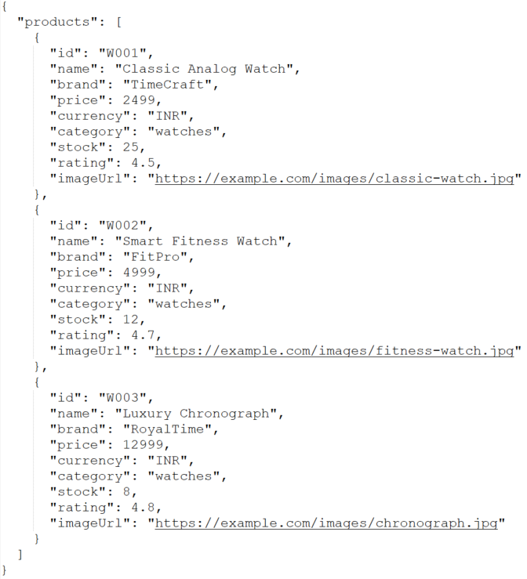
Sample Request & Response
Request url: https://api.example.com/products/watches

Slide 9
What Does a Backend Engineer Do?
A backend engineer builds and maintains the server-side part of an application.
Core responsibilities
Build REST APIs
Implement business logic
Work with databases
Implement authentication & authorization
Validate and process incoming data
Handle errors and exceptions
Integrate with other services
Write unit & integration tests
Improve application performance
Monitor and troubleshoot applications

Slide 10
Introduction to Spring & Spring Boot
Why Do We Need Spring Boot?
Challenges before Spring Boot
Benefits of Spring Boot
What is Spring Boot?
Framework Overview
Embedded Servers
Auto Configuration
Starter Projects
What Can We Build Using Spring Boot?
REST APIs
Microservices
Batch Applications

Slide 11
Spring Framework
The Spring Framework is a popular open-source Java framework used to build enterprise applications, especially backend and web applications.
What does Spring provide
Spring Core — Dependency Injection and IoC (Inversion of Control)
Spring MVC — Web applications and REST APIs
Spring Data — Easier database access
Spring Security — Authentication and authorization
Spring AOP — Cross-cutting functionality such as logging and transactions
Spring Test — Testing support

Slide 12
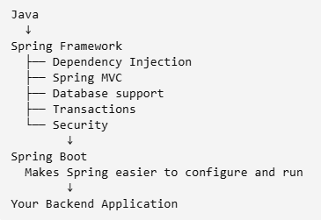
What is Spring Boot?
Spring Boot is a tool built on top of Spring that makes using Spring much easier.
Java
↓
Spring
↓
Spring Boot
Java is the programming language.
Spring is a framework that provides lots of infrastructure for Java applications.
Spring Boot makes setting up and using Spring applications much easier.

Slide 13
Core Spring Concepts

Slide 14
Dependency Injection (DI)
Benefits of DI
Types of Dependency Injection
Inversion of Control (IoC)
In the Spring Framework, IoC (Inversion of Control) is a design principle where the control of object creation, configuration, and lifecycle management is transferred from the developer to the framework.
Instead of manually instantiating classes using the new keyword, an external container manages these tasks for you

Slide 15
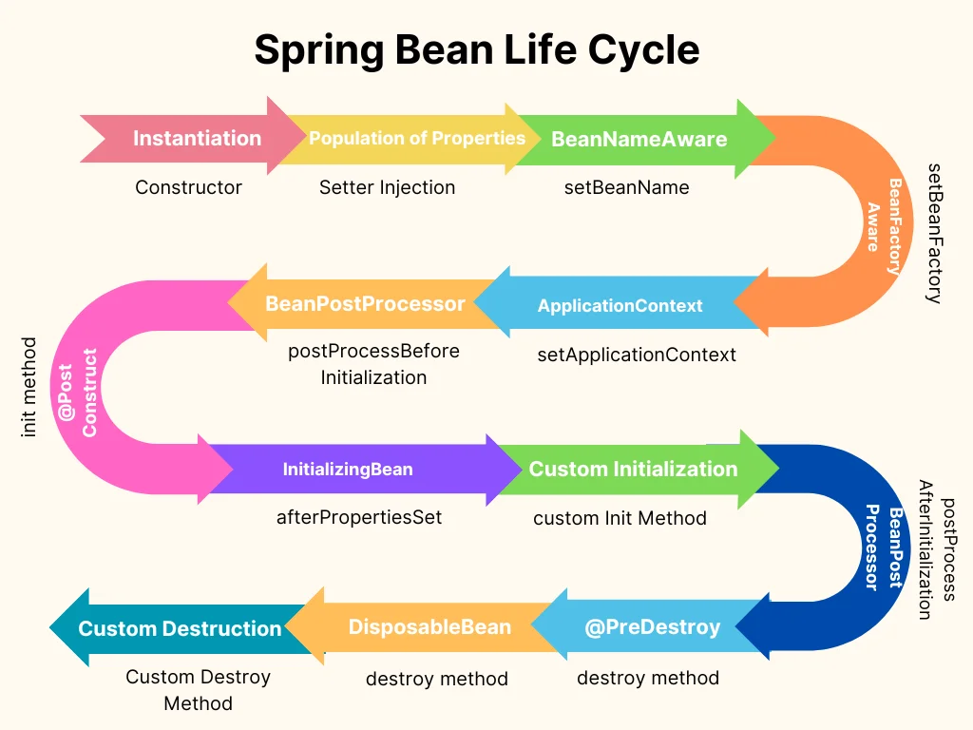
Spring Beans
What is a Bean
Bean Lifecycle (High Level)

Slide 16
Important Annotations in SpringBoot
@SpringBootApplication
@SpringBootConfiguration
@EnableAutoConfiguration
@ComponentScan
@Component
@Autowired
@Service
@Repository
@Configuration
@RestController

Slide 17
Creating a Spring Boot Project

Slide 18
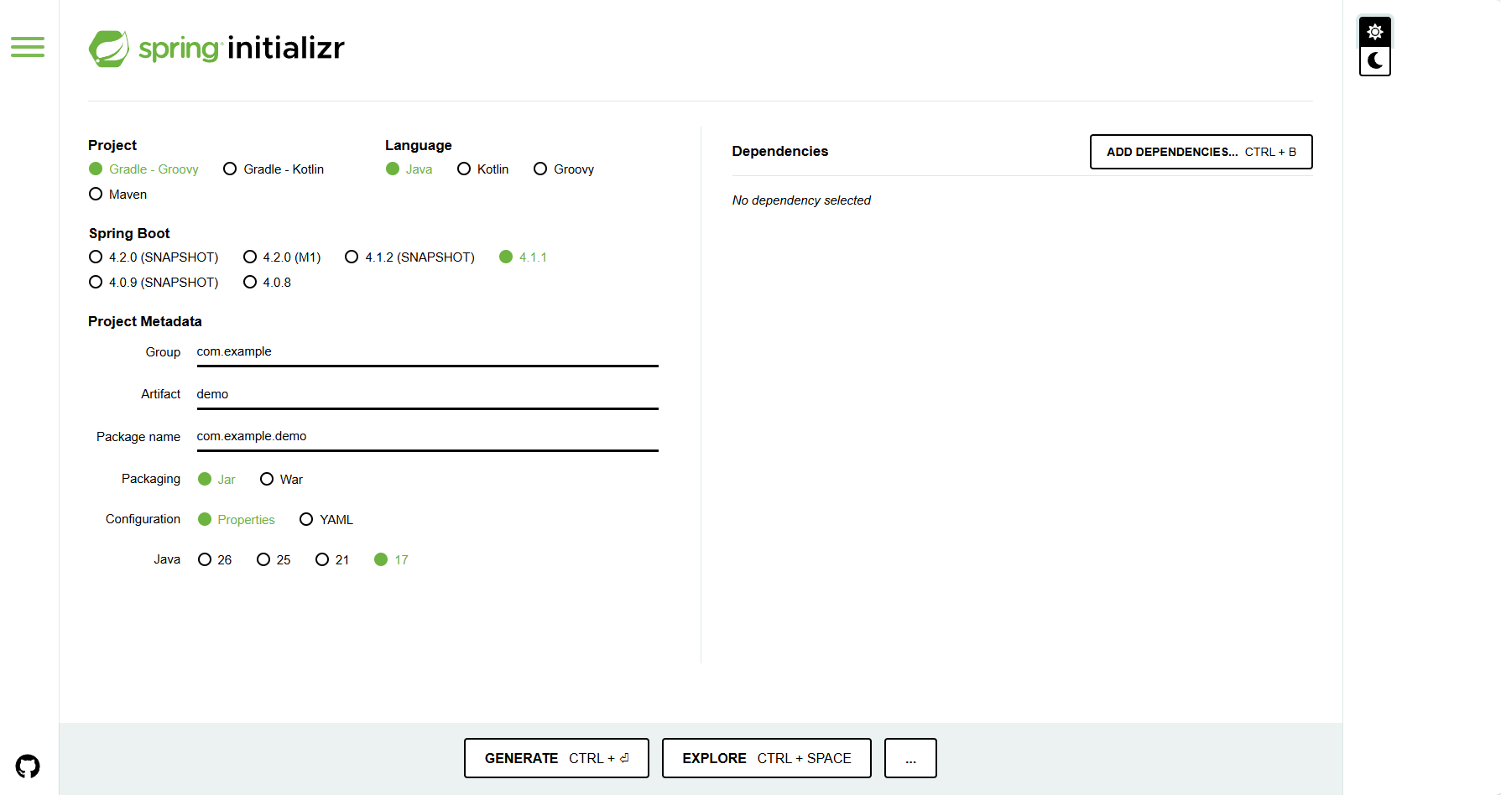
Project Creation
Spring Initializr
Build Tool (Gradle/Maven)
Language
Significance Of Group & Artifact
Packaging
Configuration
Selecting Dependencies
What Are Dependencies?
Who Owns Them?

Slide 19
Understanding Maven
Build Tool
Dependency Management
Common Maven Commands
mvn clean
mvn compile
mvn package
mvn spring-boot:run

Slide 20
POM.xml
A POM (Project Object Model) file is an XML file that serves as the fundamental building block of a Maven project. It contains information about the project and configuration details to manage dependencies, plugins, build settings, and more.
Importance of the POM File
The POM file is pivotal in Maven-based projects for various reasons:
Dependency Management: It defines project dependencies and their versions, ensuring that the required libraries are available during compilation and runtime.
Lifecycle Management: It defines the build lifecycle phases and their associated goals, allowing developers to execute tasks such as compilation, testing, packaging, etc.
Plugin Configuration: It specifies which plugins should be used in the build process and how they should be configured.
Project Metadata
Parent POM
Dependencies
Plugins

Slide 21
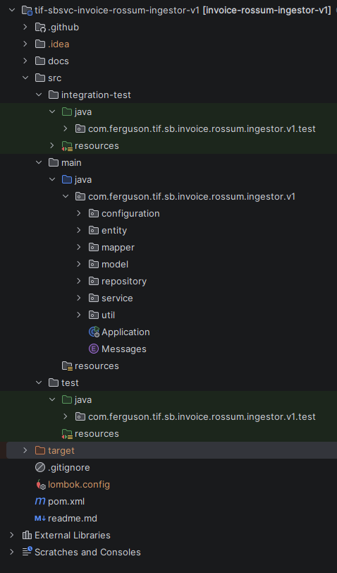
Understanding Project Structure & Layer
Benefits
Separation of Concerns
Maintainability
Testability
Types of Layers
Controller
Service
Repository
Database
Notes:
Spring Boot Folder Structure (Best Practices) | Coding Shuttle – For Detailed References

Slide 22
Configuration Files
application.properties
application.yml

Slide 23
ReST API Development

Slide 24
Fundamentals Of ReST
What is REST?
Resource Based Design
Stateless Communication
HTTP Methods
GET
POST
PUT
PATCH
DELETE
Request & Response
URL
Path Variables
Query Parameters
Request Body
JSON Response
Status Codes

Slide 25
Hands on Exercises

Slide 26
Build It Yourself
DB Integration
Order CRUD API
Customer CRUD API
External API Integration
Validation (Bonus)

Slide 27
Thank you!
FERGUSON.COM

